Slide 1
Module 20

Slide 2
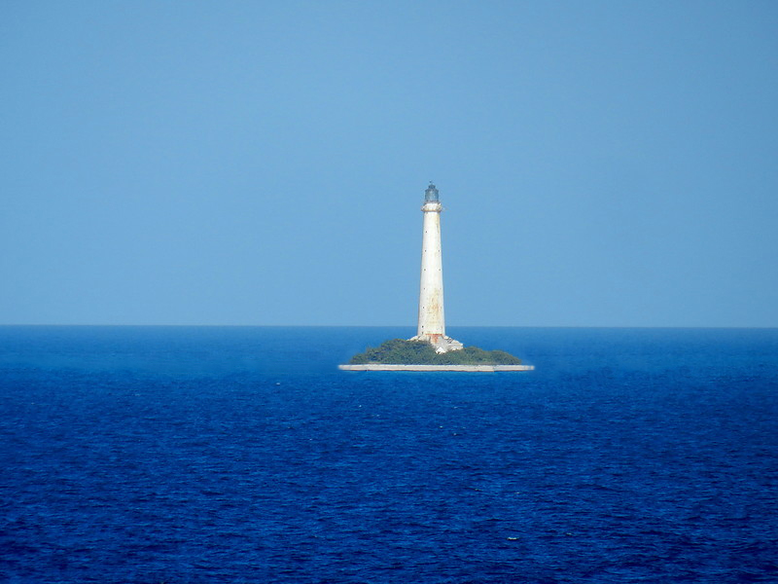
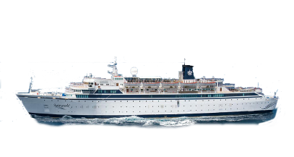
Q. From the top of a light house, an observer looks at a ship and
finds the angle of depression to be 60º. If the height of the light
house is 90 m then find how far is that ship from the light house.
Observer
A
Horizontal line
E
60º
∠EAC and ∠ACB are what type of angles?
Observe
∠EAC and ∠ACB
Alternate angles
90 m
line of sight
What can we say about these two angles ?
They are equal
60º
B
?
C

Slide 3


A
E
Q. From the top of a light house, an observer
looks at a ship and finds the angle of
depression to be 60º. If the height of the
light house is 90 m then find how far is
that ship from the light house.
For ∠ACB
60º
Ratio of opposite side and Adjacent side reminds us of _________
Consider ΔABC
Observe ∠C
Opposite side →
AB
Opposite
side
‘tan’
Adjacent side →
BC
90 m
Sol.
AB represents the height of the lighthouse.
C represents the position of ship.
60º
A represents the position of observer.
B
?
C
∠EAC = 60º
Adjacent side
∠EAC = ∠ACB
[Alternate angles]
∴
∠ACB = 60º
$$\sqrt{3}$$
tan 60º =
?
In right angled ΔABC,
tan 60º =
AB
BC
∴
$\sqrt{3}$ =
90
BC

Slide 4








A
E
Q. From the top of a light house, an observer
looks at a ship and finds the angle of
depression to be 60º. If the height of the
light house is 90 m then find how far is
that ship from the light house.
60º
90 m
Sol.
90
$\sqrt{3}$ =
Now, let us rationalise the denominator
BC
60º
∴
BC =
90
$$\sqrt{3}$$
B
?
C
∴
90
$$\sqrt{3}$$
BC =
×
$$\sqrt{3}$$
$$\sqrt{3}$$
∴ BC =
30
× 1.73
30
$\sqrt{3}$ = 1.73
∴ BC = 51.9 m
∴
BC =
90 $\sqrt{3}$
3
∴
BC =
30 $\sqrt{3}$
The ship is 51.9 m far from the lighthouse.

Slide 5
Module 21

Slide 6
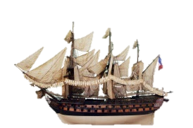
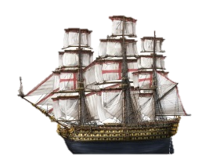
Q. As observed from the top of a 75 m high lighthouse from the
sea-level, the angles of depression of two ships are 30° and 45°.
If one ship is exactly behind the other on the same side of the lighthouse,
find the distance between the two ships.
B
Horizontal line
X
Observer
45º
30º
∠XBD and ∠BDA are what type of angles?
∠XBC and ∠BCA are what type of angles?
What can we say about these two angles ?
Observe
∠XBC and ∠BCA
What can we say about these two angles ?
Observe
∠XBD and ∠BDA
They are equal
Alternate angles
Alternate angles
They are equal
75 m
line of sight
line of sight
45º
30º
A
D
?
C

Slide 7
Q. As observed from the top of a 75 m high
lighthouse from the sea-level, the angles
of depression of two ships are 30° and 45°.
If one ship is exactly behind the other on
the same side of the lighthouse,
find the distance between the two ships.
B
X
For ∠ADB
Observe ∠ADB
Ratio of opposite side and Adjacent side reminds us of _________
Consider ΔBAD
45º
Opposite side →
AB
Opposite
side
30º
‘tan’
Adjacent side →
AD
75 m
Sol.
Height of light house (AB) = 75 m
45º
AD is the distance of one ship from
the foot of light house (AB)
30º
A
75m
D
x
C
Let the distance between
two ships (DC) be ‘x’ m
Adjacent side
tan 45º =
?
1
In right ΔBAD,
AB
tan 45º
=
AD
75
∴
1
=
AD
∴
AD
=
75m
…(i)

Slide 8






Q. As observed from the top of a 75 m high
lighthouse from the sea-level, the angles
of depression of two ships are 30° and 45°.
If one ship is exactly behind the other on
the same side of the lighthouse,
find the distance between the two ships.
B
X
For ∠ACB
Ratio of opposite side and Adjacent side reminds us of _________
Observe ∠C
45º
Opposite side →
AB
Opposite
side
30º
Adjacent side →
AC
‘tan’
1
75 m
tan 30º =
?
$$\sqrt{3}$$
Sol.
In right ΔBAC,
45º
AB
30º
tan 30º
=
A
75m
D
x
C
AC
1
75
(x + 75)m
Adjacent side
∴
=
$$\sqrt{3}$$
x + 75
$$\sqrt{3}$$
∴
=
75
$\sqrt{3}$ = 1.73
x + 75
x
$$\sqrt{3}$$
∴
x
=
75 ×
∴
=
75
– 75
0.73
∴
x
=
75(
$$\sqrt{3}$$
– 1)
∴
x
=
54.75
∴
x
=
75(
1.73 – 1)
∴
Distance between the two ships is 54.75 m

Slide 9
Module 22 Solved Example 7

Slide 10
Module 23 Solved Example 6

Slide 11
Module 24

Slide 12
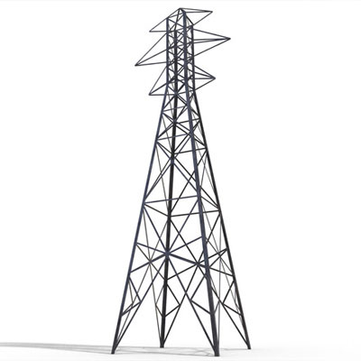
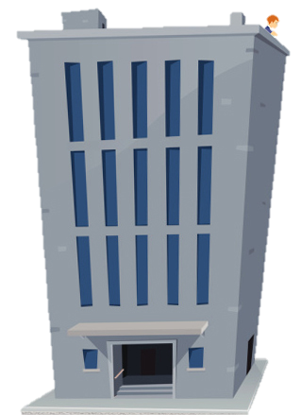
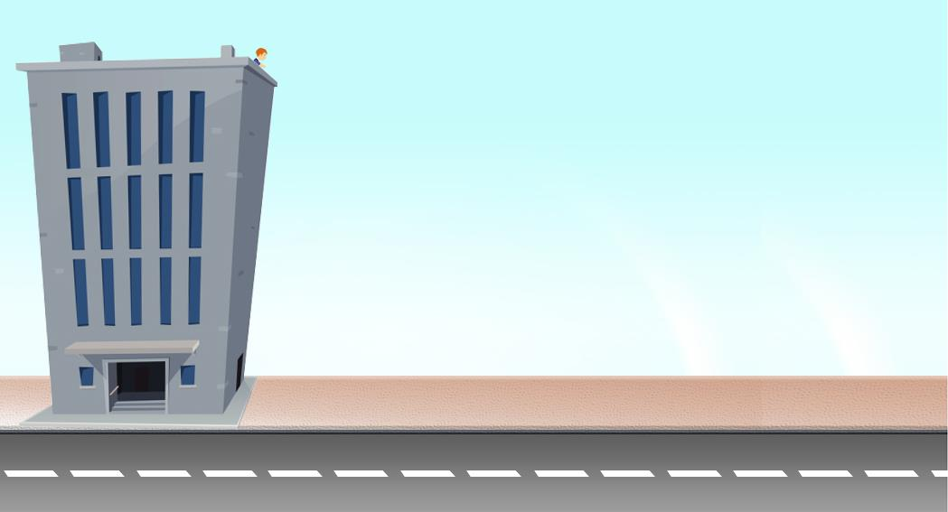
Q. From the top of a 7 m high building, the angle of elevation of the
top of a cable tower is 60° and the angle of depression of its foot
is 45°. Determine the height of the tower.
C
Top of the cable tower
line of sight
Observer
A
60º
Horizontal line
E
?
45º
7 m
line of sight
Foot of the cable tower
B
D

Slide 13
C
Q. From the top of a 7 m high building,
the angle of elevation of the top of a cable
tower is 60° and the angle of depression of
its foot is 45°.
Determine the height of the tower.
Observe CD
CD is made up of CE and ED
Ratio of opposite side and Adjacent side reminds us of _________
For ∠EAD
Adjacent side
h – 7
Observe ∠EAD
Opposite side →
ED
A
60º
‘tan’
E
h
Adjacent side →
AE
45º
7m
Sol.
Let the height of cable tower (CD) be ‘h’ m
Opposite
side
Height of the building (AB) = 7 m
7 m
7 m
oABDE is rectangle
[By definition]
∴
AB
=
ED
=
7 m
B
D
CE
ED
=
CD
+
∴
CE
+
7
=
h
?
∴
CE
=
tan 45º =
1
(h – 7) m
In right ΔAED,
ED
tan 45º
=
AE
7
∴
1
=
AE
∴
AE
=
7m

Slide 14






C
Q. From the top of a 7 m high building,
the angle of elevation of the top of a cable
tower is 60° and the angle of depression of
its foot is 45°.
Determine the height of the tower.
For ∠CAE
Opposite
side
Observe ∠A
Ratio of opposite side and Adjacent side reminds us of _________
h – 7
Opposite side →
CE
Adjacent side →
AE
A
60º
$$\sqrt{3}$$
‘tan’
tan 60º =
?
E
h
45º
7m
Sol.
In right ΔAEC,
7 m
Adjacent side
7 m
CE
tan 60º
=
AE
h – 7
B
D
∴
$$\sqrt{3}$$
=
7
$$\sqrt{3}$$
h – 7
∴
7
=
$\sqrt{3}$ = 1.73
∴
$$\sqrt{3}$$
7
+ 7
=
h
h
=
(
∴
7
$$\sqrt{3}$$
+ 1)
∴
h
=
7
(
1.73 + 1)
∴
h
=
=
7 × 2.73
19.11
∴
Height of the cable tower is 19.11 m

Slide 15
Module 25

Slide 16
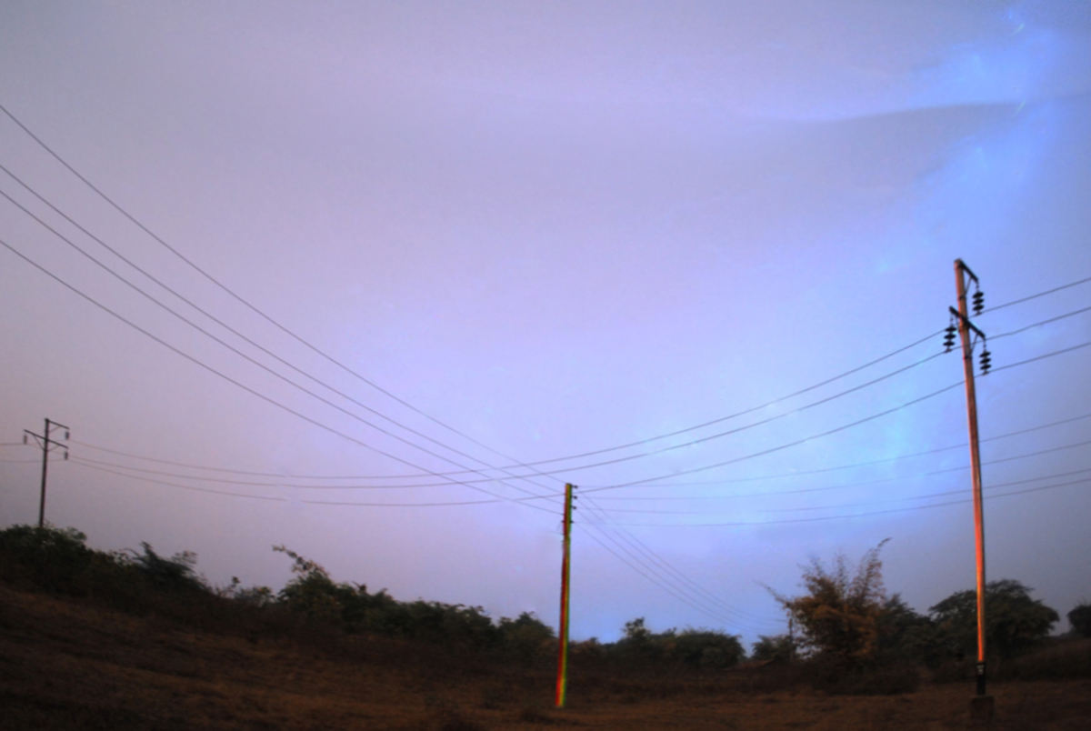
Q. Two poles of height 18 metres and 7 metres are erected
on the ground. A wire of length 22 metres is tied to the
top of the poles. Find angle made by wire with the horizontal.
Horizontal line can be drawn from point ‘A’
as well as ‘C’
A
Consider CE ⊥ AB
22 m
E
?
C
18
7 m
B
D

Slide 17
Q. Two poles of height 18 metres and
7 metres are erected on the ground.
A wire of length 22 metres is tied to
the top of the poles. Find angle made
by wire with the horizontal.
A
For ∠ACE
Opposite
side
But we know that,
Ratio of opposite side and Hypotenuse reminds us of _________
22 m
Observe ∠ACE
Consider ΔAEC
Opposite side →
AE
Observe AB
Observe oEBDC
1
11m
sin 30º =
‘sin’
Hypotenuse →
AC
2
?
18m
E
Hypotenuse
C
Sol.
AB and CD represent the heights of two poles.
AC represents the length of wire.
∠ACE is the angle made by the wire with the
horizontal.
7 m
7 m
B
D
oEBDC is a rectangle
11
∴
sin C =
CD = EB = 7m
22
AE +
EB
=
AB
1
∴
sin C =
∴
AE +
7
=
18
2
∴
AE = 11 m
1
But, sin 30º =
In right angled Δ AEC,
2
AE
sin C = sin 30º
sin C =
AC
∴
∠C = 30º
The angle made by wire with the horizontal is 30º

Slide 18
Thank You

